Slide 1
DATA ANALYSIS OF AIR QUALITY INDEX
205219001 - Abdul Jamsheed V
205219013 - Divya Anwesh Sahu
205219015 - M. Gowtham Budda

Slide 2
objective
Tackle air quality index(PM) by using big-data tools to analyze the hourly concentration of air pollutants (e.g., ozone particle matter (P1 ) and sulfur dioxide(P2). Results are queried from HDFS using HIVE and TOP 5 polluted locations are displayed. This output is visualized using TABLEAU and the locations are plotted in the map based on latitude and longitude information in the datasets

Slide 3
Collection and Processing - MapReduce
We take the Sofia air quality dataset from kaggle which has been taken from https://airsofia.info/
This dataset has the following features:
sensor_id
location
lat
lon
timestamp
P1
P2
P1 and P2 are the PM indexes from two different sensors from the same neighbourhood.
We return the longitude and latitude for the top 5 most polluted areas for that day.

Slide 4
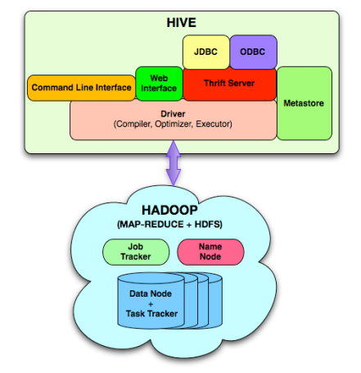
Hive
Hive is used to query data from HDFS, since tableau cannot process the data from HDFS directly.
Once data is retrieved it is sent to Tableau for data visualisation

Slide 5
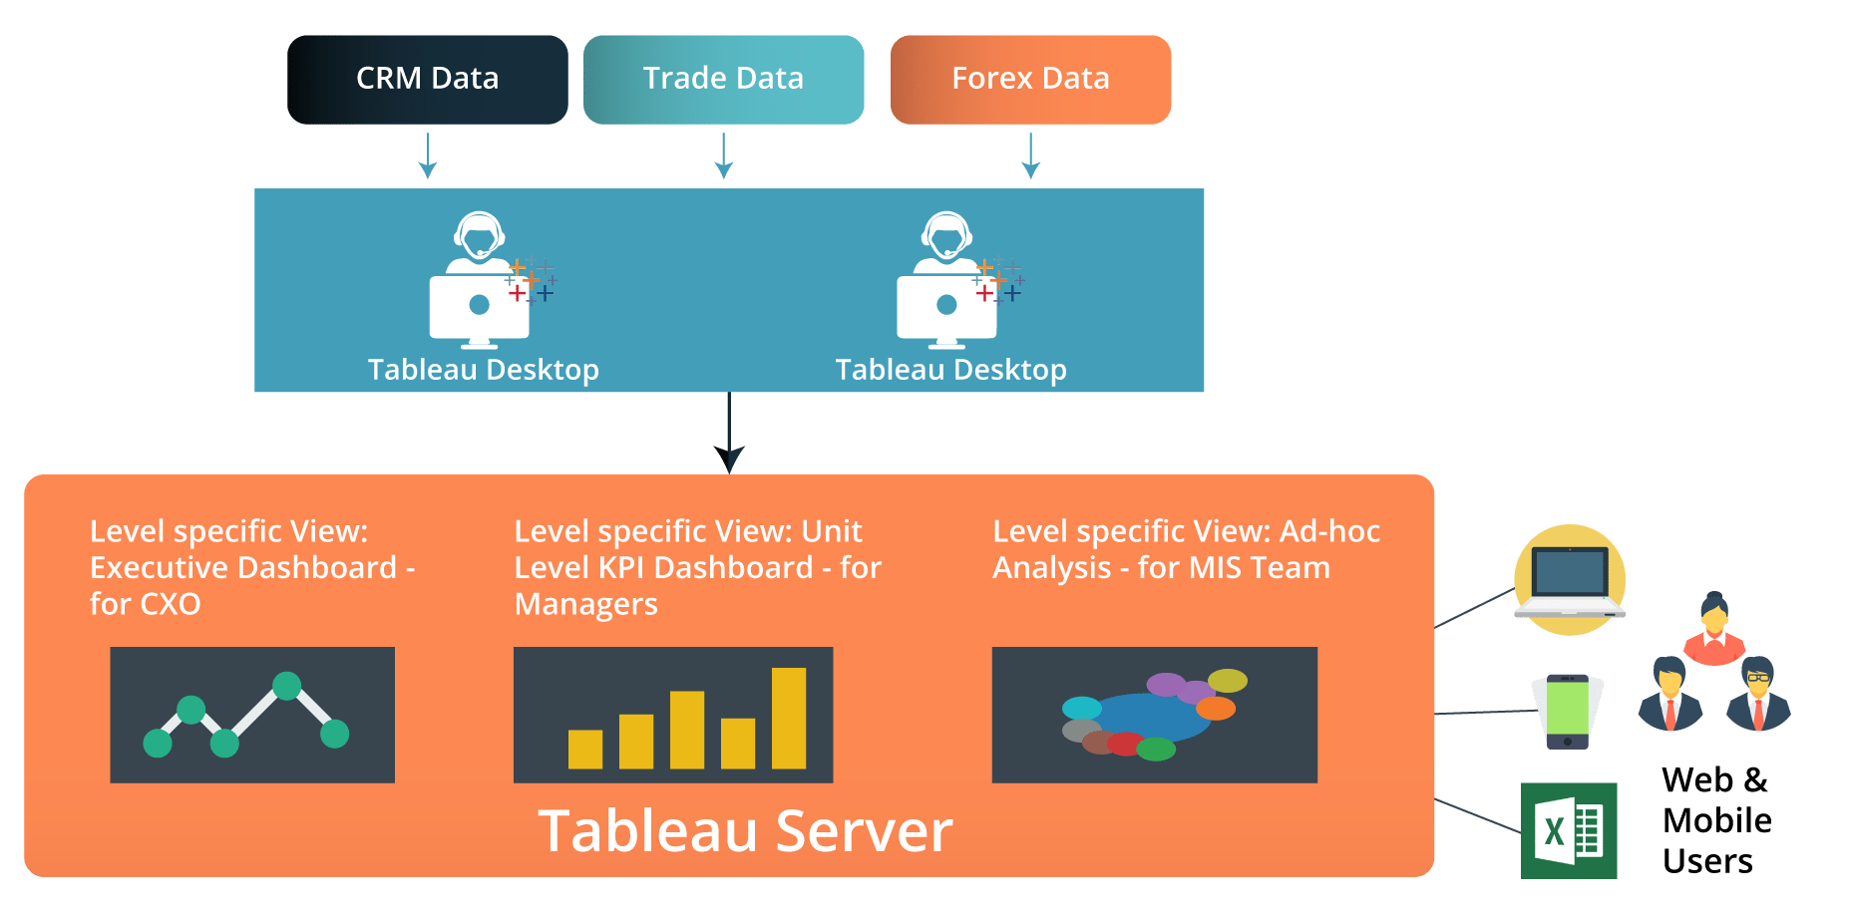
Data Visualization
Tableau is used for data visualisation.

Slide 6
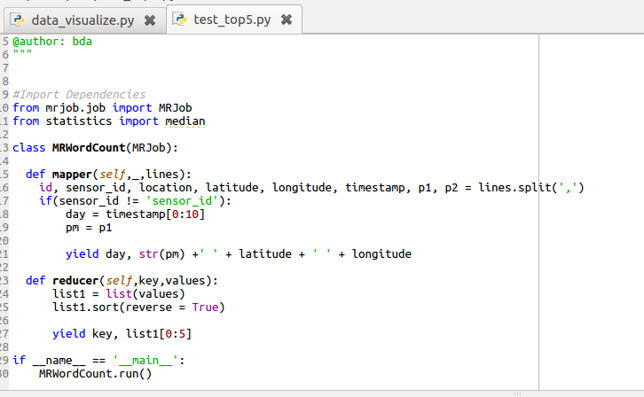

Slide 7
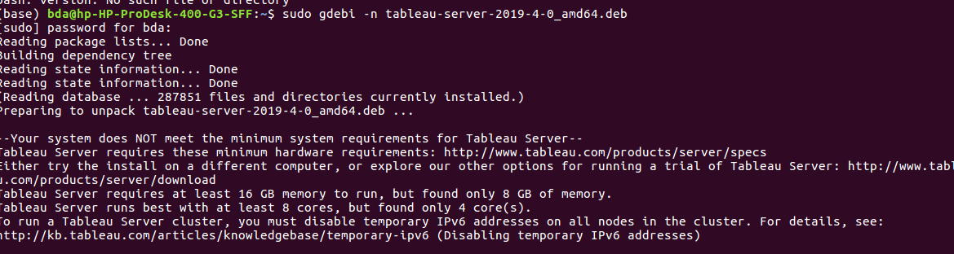

Slide 8
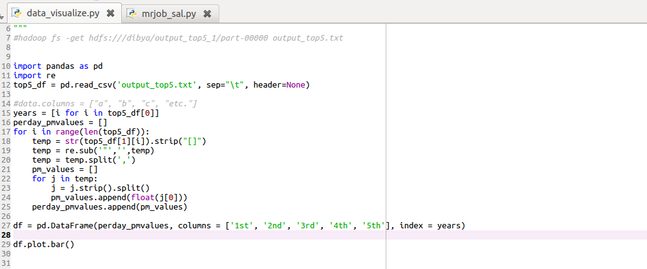

Slide 9
